Slide 1

SQL for Data Science Capstone Project
April 2021

Slide 2
Table of Contents
Executive Summary | 3-4
Project Proposal | 5-8
Descriptive Statistics | 9-12
Beyond Descriptive Statistics | 13-14
Appendix | 15-22

Slide 3
Executive Summary

Slide 4
Summary of Findings
Findings:
There is no real change in the success of various countries over time; historically successful Olympic countries have remained that way into the 21st century
Large countries with high populations and budgets are successful in Summer and Winter Olympics, regardless of climate
Smaller Northern countries have a much higher relative success rate (i.e. percentage of the total medals won in a given sport) in the Winter Olympics than smaller Southern countries do in the Summer Olympics
Smaller Northern countries have as much or more relative success than large countries in the Winter Olympics
No real difference in the amount of relative success of the top Summer vs. Winter countries
Decision:
Northern-climate countries (i.e. Canada, Scandinavian countries) should focus almost exclusively on Winter sports, where they have a high relative success, and not worry about the summer
Southern-climate countries (i.e. Australia, Mexico) should allocate funds similar to Northern-climate countries to realize similar relative success at Summer Games
Large countries (e.g. United States, Russia) can continue to have success in all seasons due to increased size and financial resources

Slide 5
Project Proposal

Slide 6
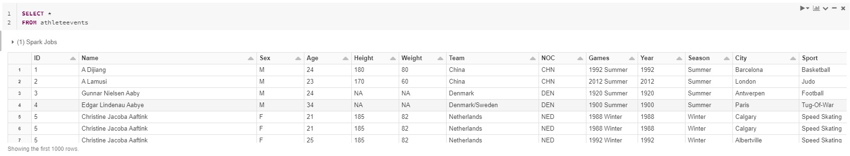
Preparing for Project Proposal
This project will analyze the athlete_events.csv file, which is a database of previous Olympic participants and results
The data was imported into Databricks
First row was specified to be headers
Inferred variable types/schema using Databricks
The table stands alone without an ERD
All analyzed variables are in the same CSV file, which was set up as its own table, so at this time, table joins aren’t necessary

Slide 7
Project Description and Questions
Project Description:
In this project, I will analyze who the dominant countries are in both the Summer and Winter Olympics as well as how that’s changed over time. I think country-specific Olympic committees, as well as staff who comments on the Olympics on various media outlets, would be interested to know. For specific countries, the analysis will inform where they are dominant and where they under-perform historically to inform financial resource allocation to sport programs and analyzing how that changes over time is a proxy for performance of past funding decisions. The analysis would also be engaging conversation in various media forms, adding a level of rigour to commentary about country athletic performance.
This analysis will cover:
Historical and current performance, by sport and by country, of various countries at both the Summer and Winter Games
Changes in performance (good or bad) for specific countries, in specific sports
Relative success of various countries in various sports and how it changes in Summer vs. Winter Games (i.e. Country X has won Y% of the total medals awarded in Z sport)

Slide 8
Project Hypothesis and Approach
Initial Hypotheses:
The same countries will be the most dominant at the Summer Games as at the Winter Games
Major population countries who are known to have had success in the Olympics (such as China and the United States) will have trended to become more dominant in recent years versus historically
Northern countries (Canada, Russia, Scandinavian countries) will have more success at the Winter Games, while southern countries (South America, Africa) will have more success at the Summer Games
Approach:
The approach will be a more macro-level analysis and not focus as much on the individual athletes, instead focusing on the results of countries over time. Predominantly, focus will be on medal count. The analysis will focus on the specific Games where countries perform better (Summer vs. Winter) as well as specialized sports by country, where medal count is the focus metric. The time field will be important too, as this is a time-based analysis which will focus on changes and trends by country over time. In summary, I am looking to understand a) who the dominant countries are in each Games; b) how dominant they are by the % of medals won in specific sports; and c) how that relative success varies by country and season.

Slide 9
Descriptive Statistics

Slide 10
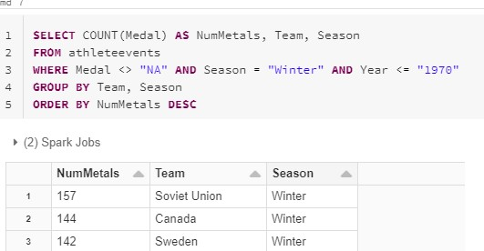
Descriptive Statistics
Evaluated Statistics:
Count of gold medals by country at both the Summer and Winter Games
Count of overall medals by country at both the Summer and Winter Games
Overall totals
Pre-1970 totals
Post-1970 totals
These were evaluated to understand how the success rates of countries change over time, as well as relative success of countries at the Summer vs. Winter Games.

Slide 11
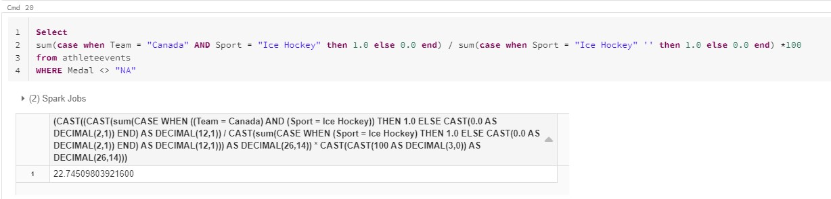
Key Metrics and Points
New Metrics:
Total medal count – aggregate of total medals excluding NA entries in the table, allowing total medal and specific medal type analysis (similar code to prev. slide)
Relative success of a country in a specific sport – used to compare how well countries do in a specific sport, looking for differences between countries and seasons
Key Points about Data:
Some issues with data cleanliness (i.e. unique country entries for “United States”, “United States-1”, “United States-2”)
This may affect counts and standing of any countries affected

Slide 12
Hypothesis Follow-Up
Discussion of Accuracy:
While there is some overlap in dominant countries (by both gold and total medals) between Summer and Winter Games, there are clear differences
There does not appear to be a significant trend towards more dominance of traditionally large population centres in recent years
Northern countries (Canada, Scandinavian) appear to have even more relative success than initially thought in the Winter Games with top-10 overall medal counts, but the trend toward Southern/warmer country success at Summer Games appears less pronounced
Because of the skew toward Northern country success at the Winter Games especially, it will be interesting to understand if they receive a higher percentage of overall medals in that sport, or if there are just more medals given out in the Summer Olympics and there is no difference in terms of relative success within a sport.
Additional Questions:
More granularity – is there specific sports within the Summer and Winter Games that the top countries excel at versus having more parity with other countries?
Further investigation needed to points 2 and 3 – how much more dominant are countries like the US, Russia and China over time? How much does country climate influence seasonal Olympic success?

Slide 13
Beyond Descriptive Statistics

Slide 14
Additional Questions
Are there specific sports within the Summer and Winter Games that the top countries excel at versus having more parity with other countries?
Yes – there is a large difference in the relative success of top countries in certain sports over others
Completed a ratio analysis calculating the percentage of total medals won by the top country in top sports (Athletics, Swimming, Gymnastics in Summer; Cross Country Skiing, Alpine Skiing and Ice Hockey in Winter)
Range from 7% of total gymnastics medals won by the United States, to 35% of total swimming medals won by the United States
Midpoint = 23% of total ice hockey medals won by Canada
How much more dominant are countries like the US, Russia and China over time?
The high medal-earning countries are similar in both the Summer and Winter Olympics pre-1970 and post-1970
1970 was selected as the cutoff year for recent success analysis
How much does country climate influence seasonal Olympic success?
Fairly significantly - shown especially in the Winter Olympics where cooler countries who are smaller (e.g. Canada, Sweden, Norway, Finland) are all top-10 overall medal-earners and not present near the top of the Summer Olympics medal ranks
There does not appear to be as significant of a skew toward warmer countries in the high medal-earners at Summer Olympics
High-population, historically powerful countries (United States, Soviet Union, Germany) are high medal-earners regardless of season

Slide 15
Appendix

Slide 16
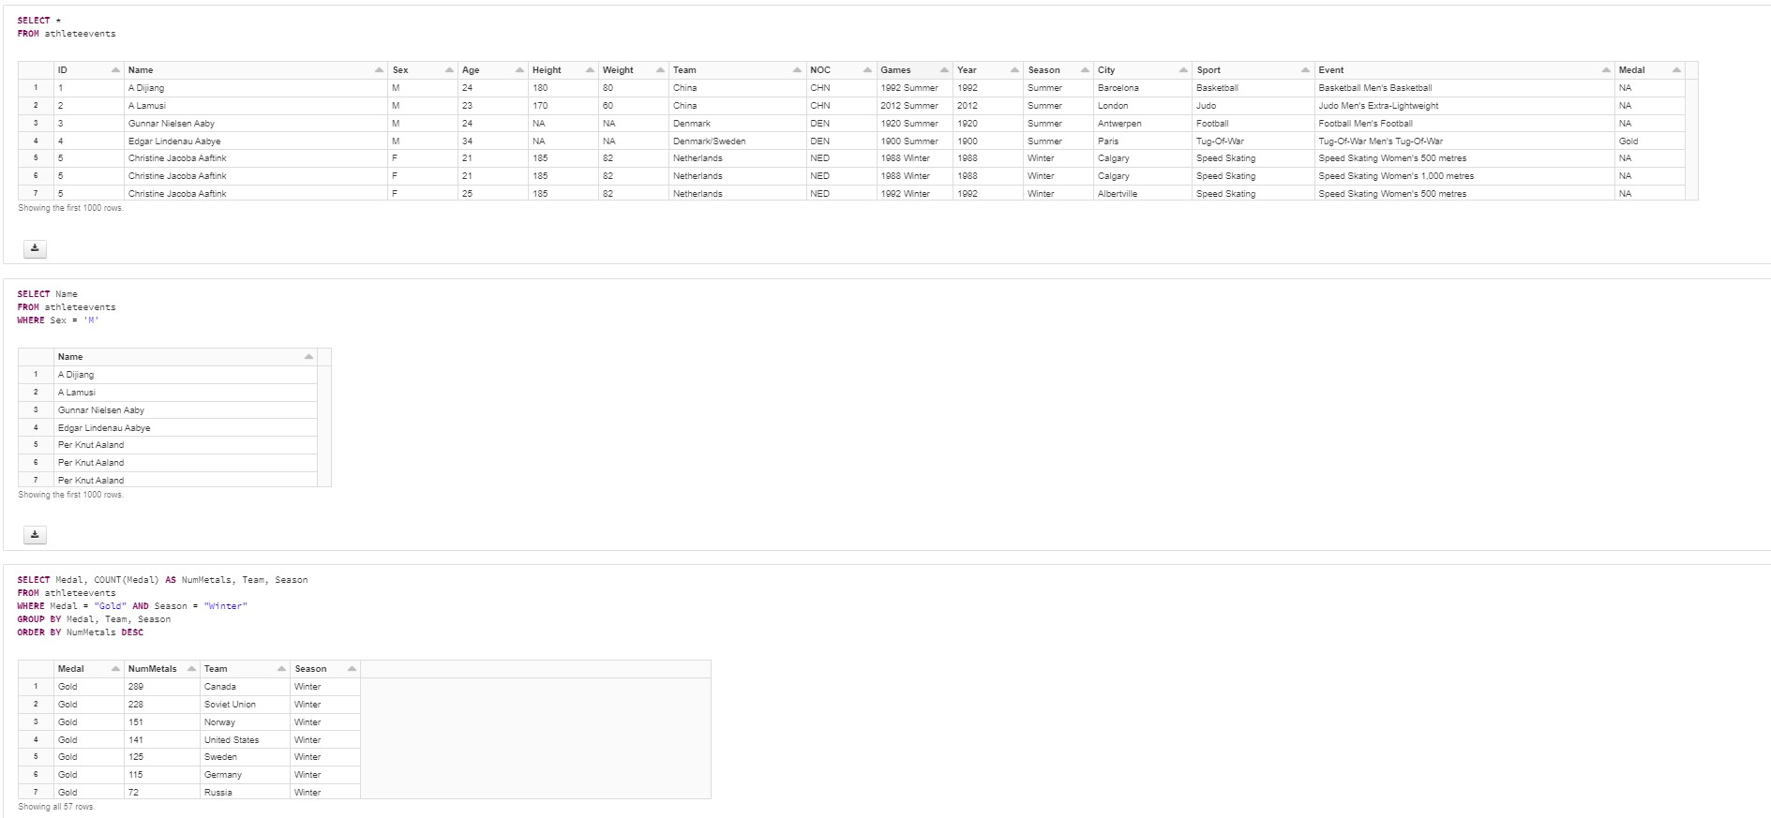
Code Block #1
Code is published at: https://databricks-prod-cloudfront.cloud.databricks.com/public/4027ec902e239c93eaaa8714f173bcfc/2039372493732929/2234772448060114/851099958206904/latest.html

Slide 17
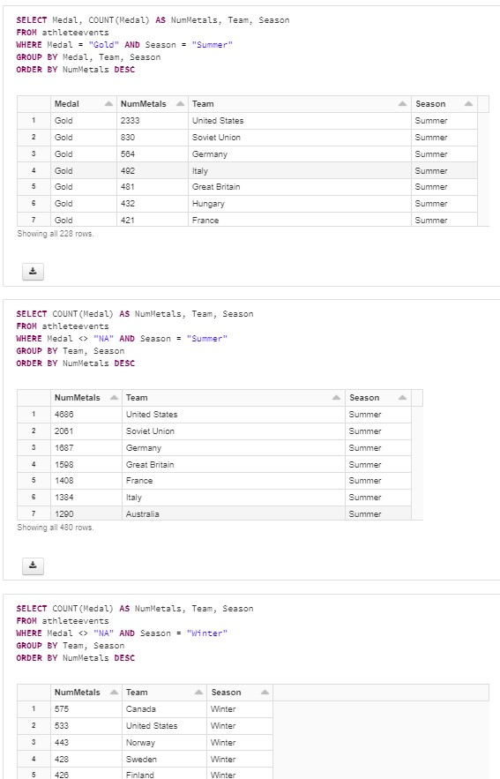
Code Block #2
Code is published at: https://databricks-prod-cloudfront.cloud.databricks.com/public/4027ec902e239c93eaaa8714f173bcfc/2039372493732929/2234772448060114/851099958206904/latest.html

Slide 18
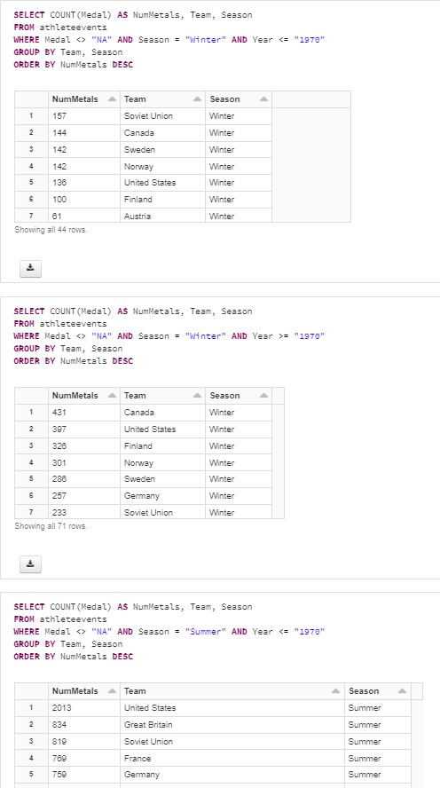
Code Block #3
Code is published at: https://databricks-prod-cloudfront.cloud.databricks.com/public/4027ec902e239c93eaaa8714f173bcfc/2039372493732929/2234772448060114/851099958206904/latest.html

Slide 19
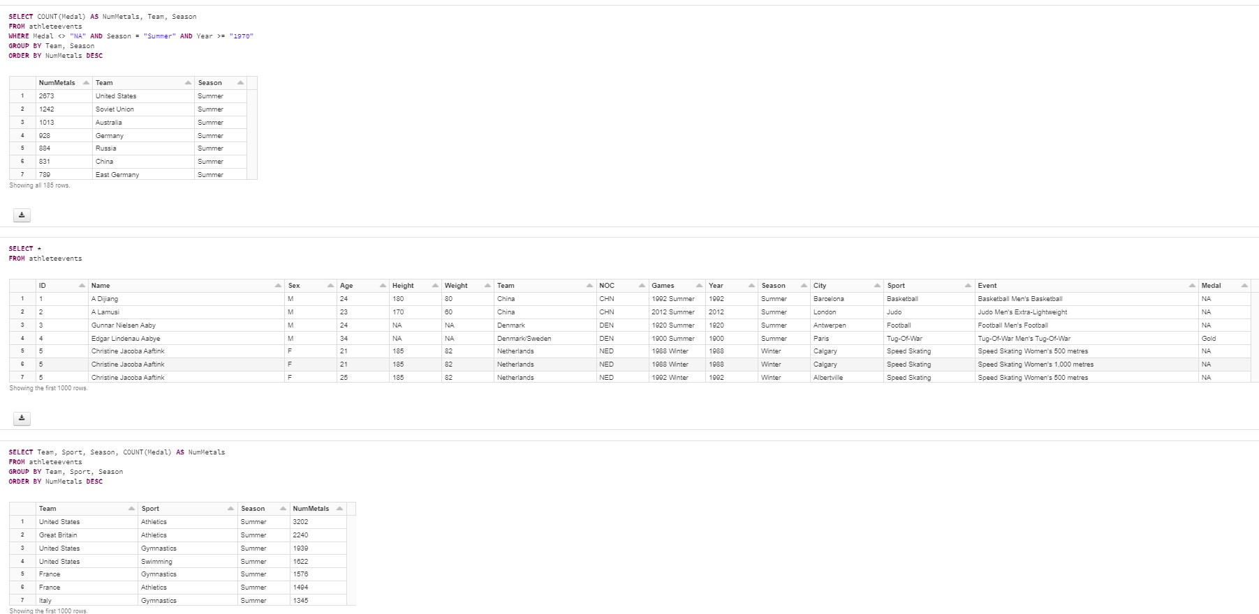
Code Block #4
Code is published at: https://databricks-prod-cloudfront.cloud.databricks.com/public/4027ec902e239c93eaaa8714f173bcfc/2039372493732929/2234772448060114/851099958206904/latest.html

Slide 20
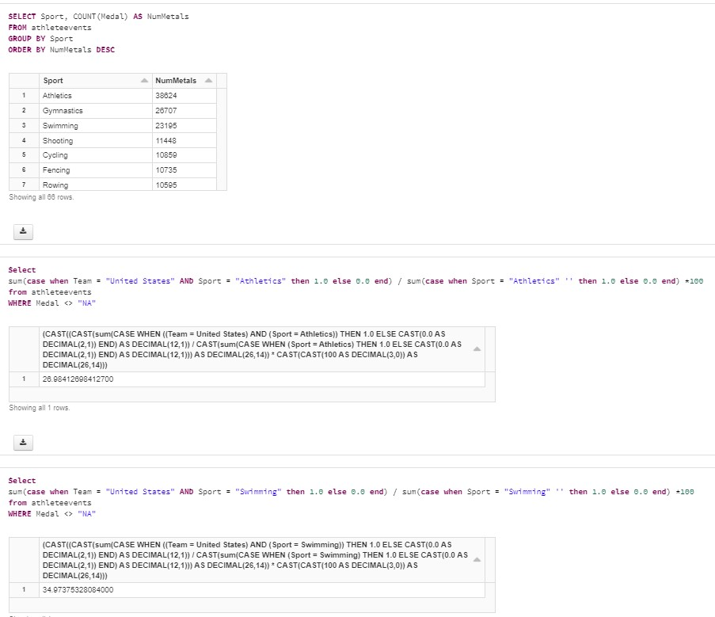
Code Block #5
Code is published at: https://databricks-prod-cloudfront.cloud.databricks.com/public/4027ec902e239c93eaaa8714f173bcfc/2039372493732929/2234772448060114/851099958206904/latest.html

Slide 21
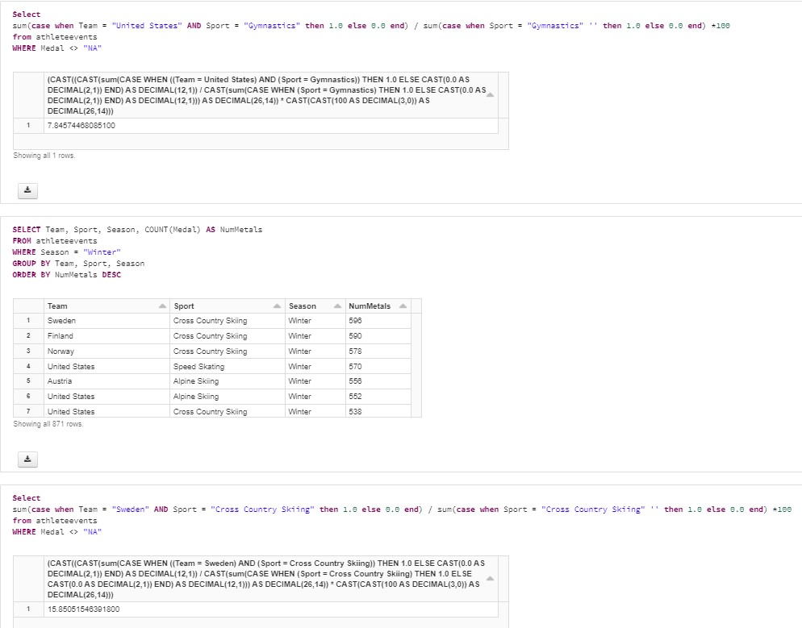
Code Block #6
Code is published at: https://databricks-prod-cloudfront.cloud.databricks.com/public/4027ec902e239c93eaaa8714f173bcfc/2039372493732929/2234772448060114/851099958206904/latest.html

Slide 22
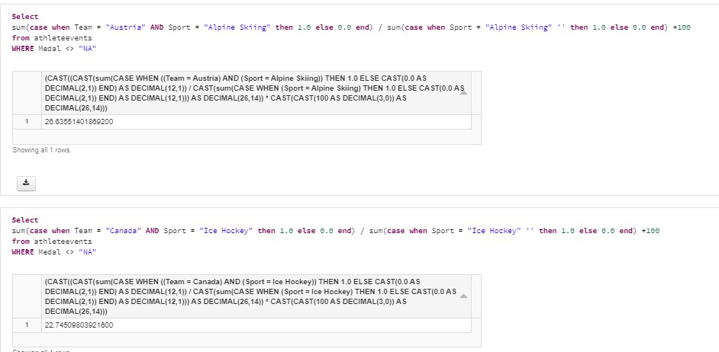
Code Block #7
Code is published at: https://databricks-prod-cloudfront.cloud.databricks.com/public/4027ec902e239c93eaaa8714f173bcfc/2039372493732929/2234772448060114/851099958206904/latest.html

